Slide 1

WPDD202: Webpage Design & Development
Version 2 – 18th December 2015

Slide 2
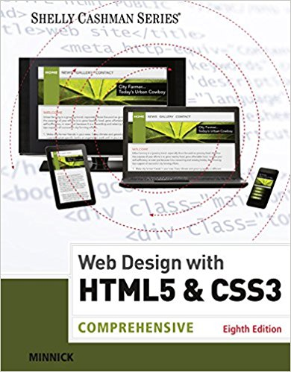
Resource Material
Web Design with HTML & CSS3: Comprehensive, 8th Edition
Jessica Minnick; Lisa Friedrichsen
ISBN-10: 1305578163 | ISBN-13: 9781305578166 © 2017
Cengage Learning Australia

Slide 3
Chapter 9
Integrating Audio and Video

Slide 4
Chapter Objectives
Describe the benefits and limitations of multimedia in websites
Identify audio formats
Identify video formats
Describe a plug-in
Understand codecs
Understand and create audio elements

Slide 5
Chapter Objectives (continued)
Understand and create video elements
Identify common audio attributes
Identify common video attributes
Understand the source element
Test audio elements
Test video elements

Slide 6
Using Multimedia
Multimedia – It is the fusion of text, images, sound, and video to exhibit an idea or convey a message
Many websites use videos to publicize products, to please visitors, or to provide instruction

Slide 7
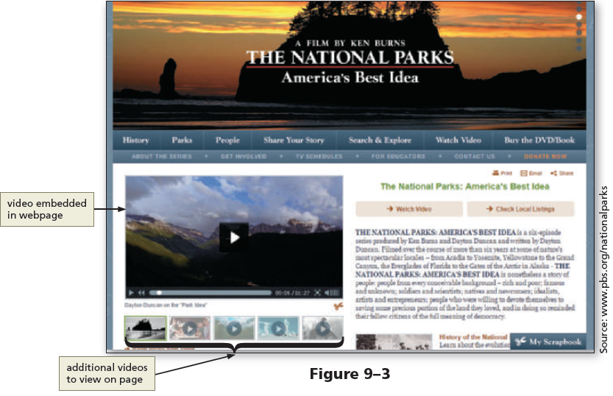
Using Multimedia (continued 1)

Slide 8
Using Multimedia (continued 2)
Podcasts – They are a series of audio or video clips released in a sequence and are popular in home, academic, and corporate settings

Slide 9
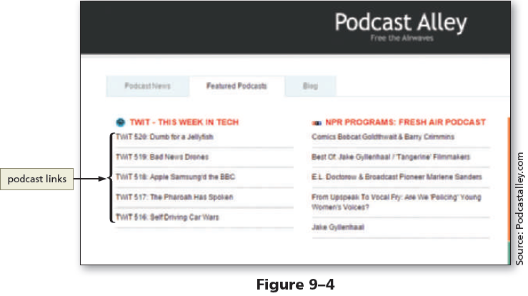
Using Multimedia (continued 3)

Slide 10
Creating Multimedia Files
One can obtain multimedia files by creating them or finding files that are already available
Audio files can be created using:
a microphone
a software designed to edit digital files, such as Audacity
a free, open-source audio editor
Adobe Audition, which can be purchased as part of the Adobe Creative Cloud

Slide 11
Creating Multimedia Files (continued 1)
In order to use any portion of files that have been professionally developed, the copyright and licensing requirements must be understood and followed
Video files can be created using a digital camcorder, a digital camera, or even a smartphone to create clips that can be included on a webpage
To find multimedia resources on the web that are available free of copyright restrictions, search for “public domain audio or video”

Slide 12
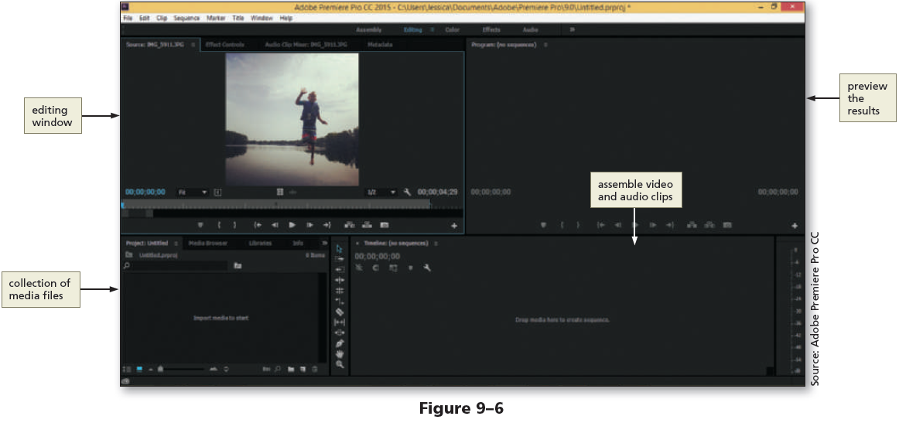
Creating Multimedia Files (continued 2)

Slide 13
Embedded vs. External Multimedia
Embedded Multimedia
The embedded media files appear within the webpage along with the audio or video player controls
Visitors use the controls to play or stop the media
External Multimedia
The external media is displayed out of context with the webpage that contains the link
Website visitors click a link to access external media files

Slide 14
Embedded vs. External Multimedia (continued 1)
Embedding media is similar to inserting inline images
Prior to HTML5, the object element was used to insert embedded content, including multimedia
Two new elements introduced by HTML5, audio and video, can be used as an alternative to the object element

Slide 15
Embedded vs. External Multimedia (continued 2)
Using external links is a common web development practice
For example, sites that provide video resources, such as YouTube, use external media files and the embed element, which defines a container for an external application or interactive content (also called a plug-in)

Slide 16
Media Players and Plug-Ins
Media player – A computer software that is used to play multimedia files
Plug-in – An extra software added to browsers (or other programs) to provide a capability that is not inherent to the browser
Plug-in is also called an add-in or add-on
For embedded media files to work in a browser, website visitors need to have the correct plug-in

Slide 17
HTML5 and Multimedia
Built-in media support is introduced in HTML5 through the audio and video elements
Web developers can easily embed media into HTML documents using the audio and video elements

Slide 18
Flash
Flash, or Adobe Flash, has been used within websites for approximately 20 years
It can be used to create animations or movie files
Flash files require the browsers to have a Flash plug-in and end with the .swf file extension
Since the iOS operating system does not support flash, web developers have embraced JavaScript to incorporate additional interactivity within their websites

Slide 19
Java Applets
Java applet – A small program created with Java, a programming language
If browsers have installed and enabled Java, Java applets can be embedded within a webpage
The use of Java applet in today’s modern websites is deteriorating

Slide 20
Object Element
The HTML object element is used to embed multimedia objects such as Flash files, Java applets, PDF files, and ActiveX controls
The param element is used to define parameters for plug-ins embedded with an object element

Slide 21
Object Element (continued)
The following is an example of the object element
<object data="audio.wav">
<param name="autoplay" value="true">
</object>
In this example, an audio file named audio.wav is embedded on the webpage
The autoplay parameter is set to true, meaning the audio starts playing when the webpage opens

Slide 22
Integrating Audio
Audio blended within a webpage should have a definite purpose and should provide added value or instruction
The time taken for a browser to load the audio file should also be considered
One favored way that websites use audio is to provide links to music files that visitors can play or download

Slide 23
Audio File Formats
The three audio file formats supported by the HTML5 audio element are .mp3, .ogg, and .wav
Audio converter software can be used to convert files from one audio format to a supported format
File compression techniques are used to reduce the size of the audio files for the web, though they can also diminish the sound quality

Slide 24
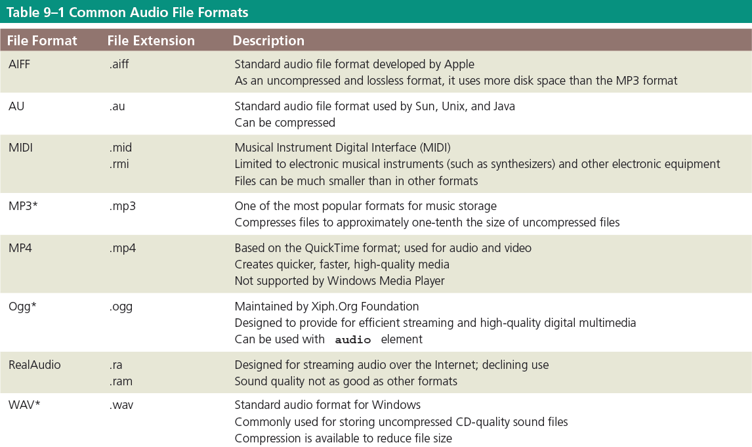
Audio File Formats (continued)

Slide 25
File Compression and Codecs
Codec – A compression technology used to compress images, audio, and video files
The word codec is short for code/decode because it consists of an encoder, which compresses the file, and a decoder, which decompresses the file
Although the page load time is improved using codecs, compressing a media file too much leads to loss of sound quality

Slide 26
HMTL5 audio Element
The audio element is used to define sound, such as music or other audio streams
Text content should be inserted between the <audio> and </audio> tags because browsers that do not support the audio element ignore the <audio> tag to alert users

Slide 27
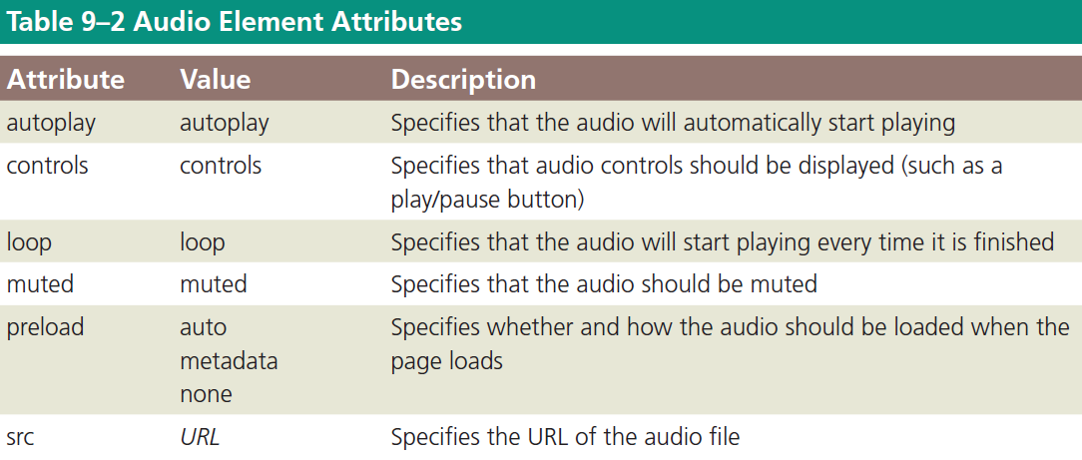
HMTL5 audio Element (continued 1)

Slide 28
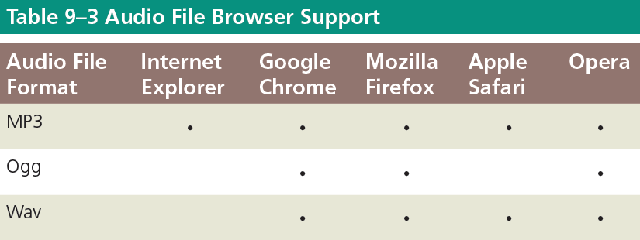
HMTL5 audio Element (continued 2)

Slide 29
HMTL5 audio Element (continued 2)
<audio controls> <source src=“aud1.ogg" type="audio/ogg"> <source src=“aud1.mp3" type="audio/mpeg"> Your browser does not support the audio element. </audio>
The controls attribute adds audio controls, like play, pause, and volume.
The <source> element allows you to specify alternative audio files which the browser may choose from. The browser will use the first recognized format.
The text between the <audio> and </audio> tags will only be displayed in browsers that do not support the <audio> element.

Slide 30
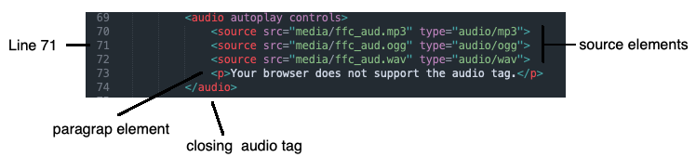
To Add Audio to the Home Page
File name: index.html
Note: autoplay may not working on browsers including Google Chrome.
Here: https://developer.chrome.com/blog/autoplay/ would give you more information

Slide 31
Video File Formats
The three video file formats supported by the HTML5 video element are .mp4, .ogg, and .webm
Video converter software can be used to convert an unsupported video file format to a supported format

Slide 32
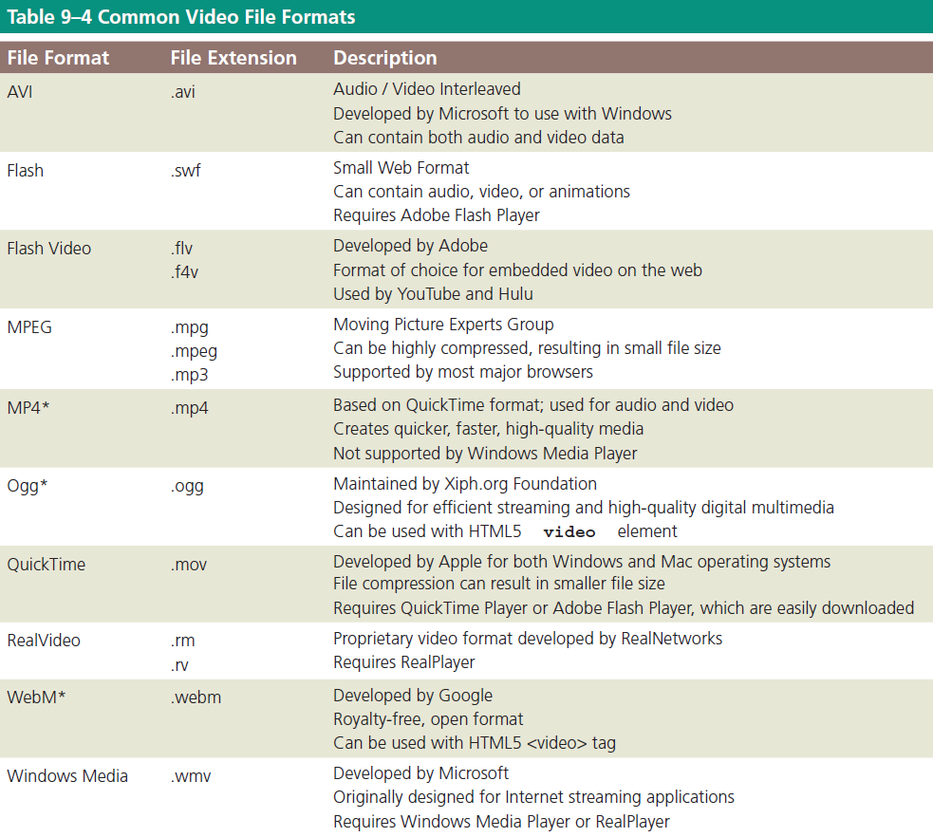
Video File Formats (continued)

Slide 33
HTML5 video Element
Three HTML elements can be used to incorporate videos in a webpage: embed, object, and video
The embed element is used to embed multimedia elements in HTML pages
If Flash is not supported by browsers, the video specified in the embed element will not play

Slide 34
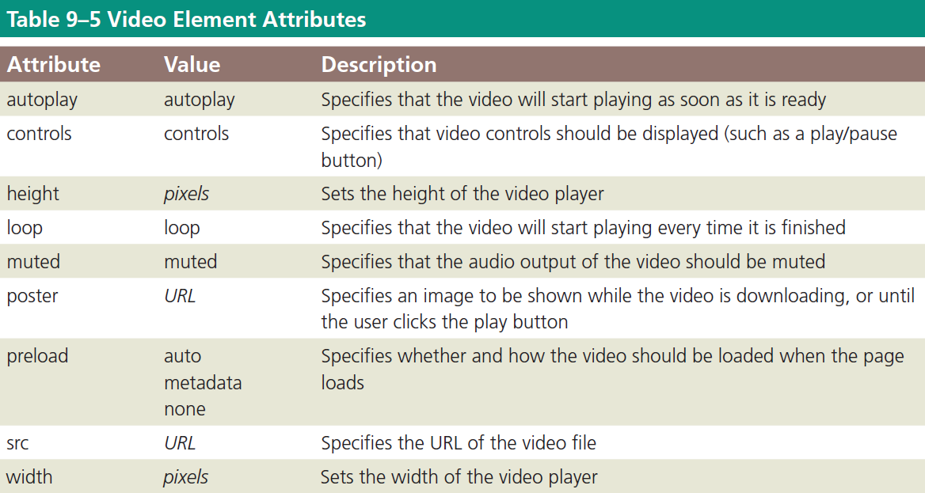
Using the video Element

Slide 35
Using the video Element (continued 1)
Text content should be inserted between the <video> and </video> tags because browsers that do not support the video element ignore the <video> tag to alert users
The following sample code shows how to use the video element to insert a video file named advertisement.mp4 in a webpage

Slide 36
Using the video Element (continued 2)
<video width="320" height="240" controls="controls">
<source src="advertisement.mp4" type="video/mp4">
<p>Your browser does not support the HTML5 video element.</p>
</video>
In the above example, the code sets the dimensions of the video (320 pixels by 240 pixels) and displays the playback controls

Slide 37
Using the video Element (continued 3)
If the browser does not support the video element, the user is alerted
The controls attribute adds video controls including play, pause, and volume
The video element allows multiple source elements, which can link to different video files

Slide 38
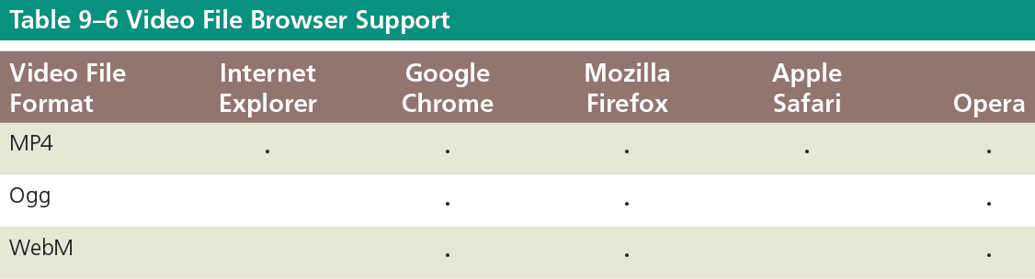
Using the video Element (continued 4)

Slide 39
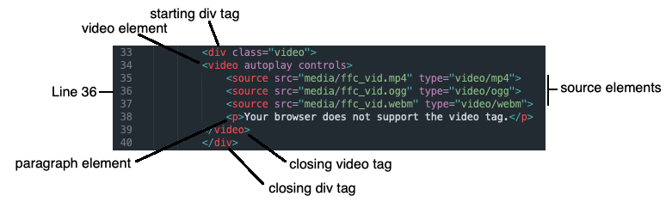
To Add Video to the About Us Page
File name: about.html

Slide 40
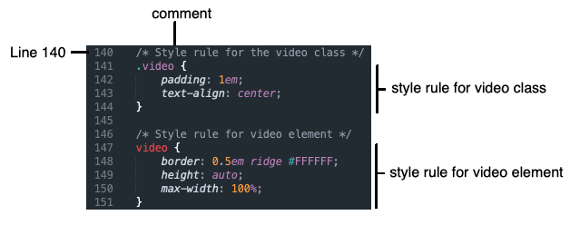
To Style the Video
File name: styles.css

Slide 41
To Validate the Style Sheet
New webpage files should always be run through W3C’s validator to check the document for errors
Validating helps to identify and correct errors in a document
Validation acts as an effective troubleshooting tool during the development process
Validation adds a valuable level of professionalism to the work

Slide 42

kent.edu.au Kent Institute Australia Pty. Ltd. ABN 49 003 577 302 ● CRICOS Code: 00161E ● RTO Code: 90458 ● TEQSA Provider Number: PRV12051

